Slide 1
A
BASIC SHELL
IMPLEMENTATION

Slide 2

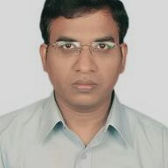
Guided By-
OUR TEAM
Dr. ANBUNATHAN R , Founder & CEO, DigiTran Solutions, Bangalore, Adjunct Professor, Department of Computer Science & Engineering
Omsri Sainadh Reddy (ENG18CS0198)
Paritala Sai Krishna Anoop (ENG18CS0202)
Pranav Dasika (ENG18CS0213)
Y Nithin Sameer (ENG18CS0195)

Slide 3
PROBLEM STATEMENT
To implement an Android application that presents a working model of a basic shell on which the users can interact and pass basic commands.

Slide 4
INTRODUCTION
The goal of our project is to build an android application incorporating lexical analysis that is used to pass commands, creates files and folders and perform the basic functions and mimic a working basic shell.

Slide 5



OBJECTIVES
User friendly
Efficient
Execution of the basic commands

Slide 6

Benefits of our project
To provide a basic understanding of how the concepts of parsing and lexical analysis work using an interpretation of the basic shell using an android application.
This application provides a way for the user to test out how the basic commands in a shell work and shows them the working of the concepts involved.
The concepts such as lexical analysis and parsing are high level computer science concepts and this is a step towards making them understandable.

Slide 7
Technologies and Developer tools used
Technologies used
Developer tools used
Lexical analysis
Android Application
RAM:
  8GB RAM or above
Processor
  Intel i5 or above
Graphical Processing Unit (GPU)
  Intel graphics or Nvidia equivalent processor
Storage
  512GB HDD/SDD or above

Slide 8
Software, Tools and Testing Tools
Software | Tools | Testing Tools
Spyder (an Python IDE) | Android Developer Framework | Android device with Android 8.0 or above
Pycharm (an Python IDE) | Lexical Analysis | An AVM

Slide 9
Expected Risks, Deliveries and Milestones
Risks
Deliveries
Milestones
Improper issuing of shell commands resulting in the corruption of the file due to limited performance capability of the application.
Performance issues of Android device
A functional Android app that allows the user to input commands into the application interface mimicking the shell in an OS
Front end implementation
Back end implementation
Successful testing

Slide 10
DESIGN
STEP 1
STEP 3
STEP 2
Changing the current working directory. We use os.chdir().
Handling the current working directory. We use os.getcwd().
Creating a directory using os.mkdir() & os.makedirs().

Slide 11
DESIGN
STEP 4
STEP 6
STEP 5
Deleting directory or files using Python. We use os.remove() $ os.rmdir().
Listing out files and directories with Python using os.listdir().
Executing other functions such as os.name(), os.error(), os.popen(), os.close(), os.rename(), etc.

Slide 12



DESIGN
WIDGETS USED
The application consists of layout using an xml file containing various elements offered by the android library.
TEXT VIEWS
EDIT TEXTS
BUTTON

Slide 13
FLOW CHART

Slide 14
YES
NO
YES
YES
NO
NO
Exist in program directory
Program using Module executes
Input modules
Exist in Python
START
Display output
Exist in default directory
END

Slide 15
FRONT END SCREENSHOTS

Slide 16
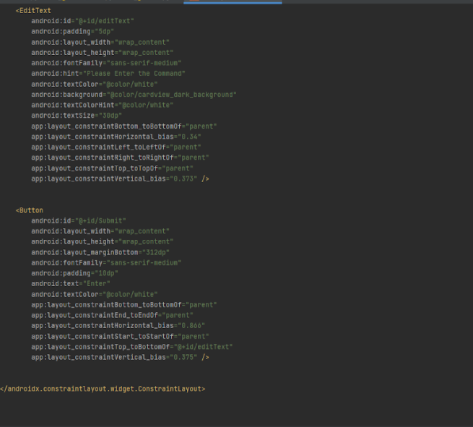

Slide 17
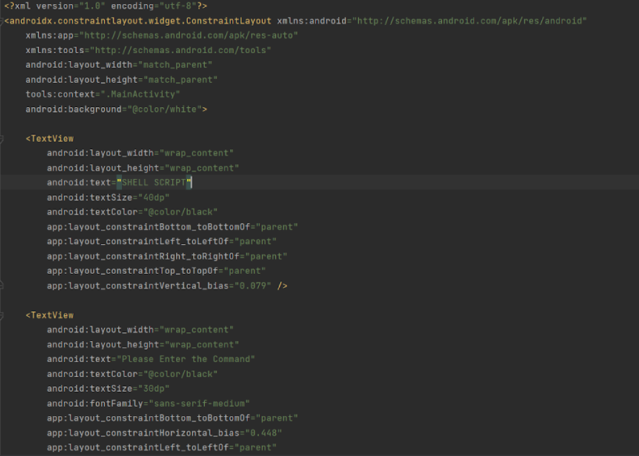

Slide 18
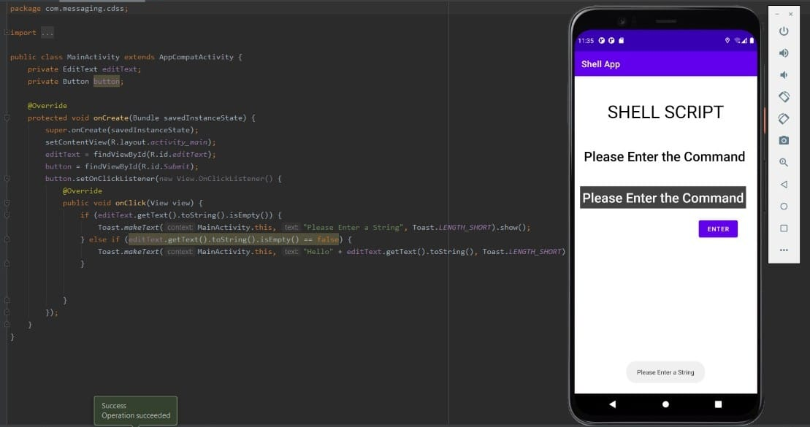

Slide 19
BACK END SCREENSHOTS

Slide 20
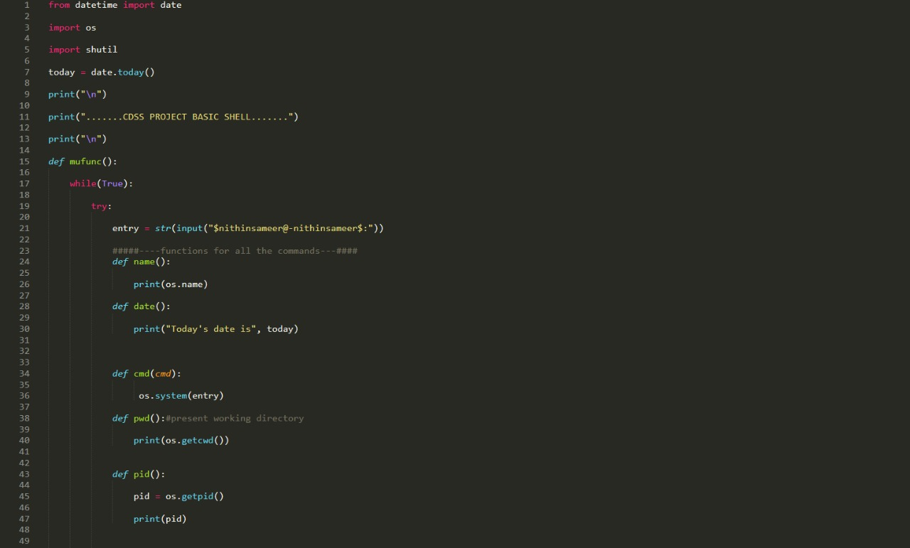

Slide 21
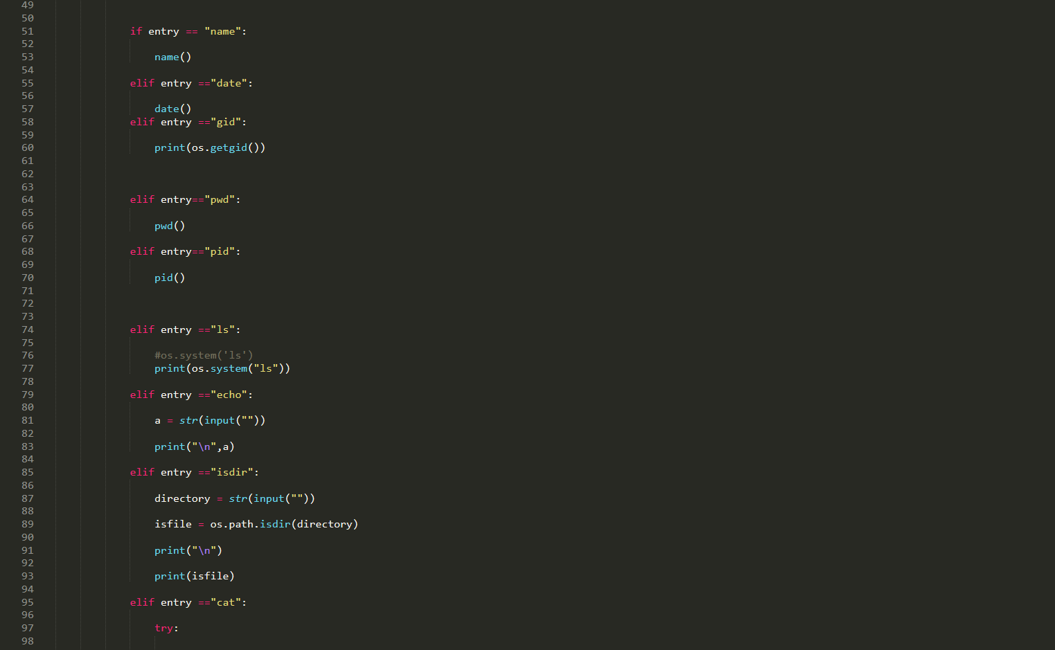

Slide 22
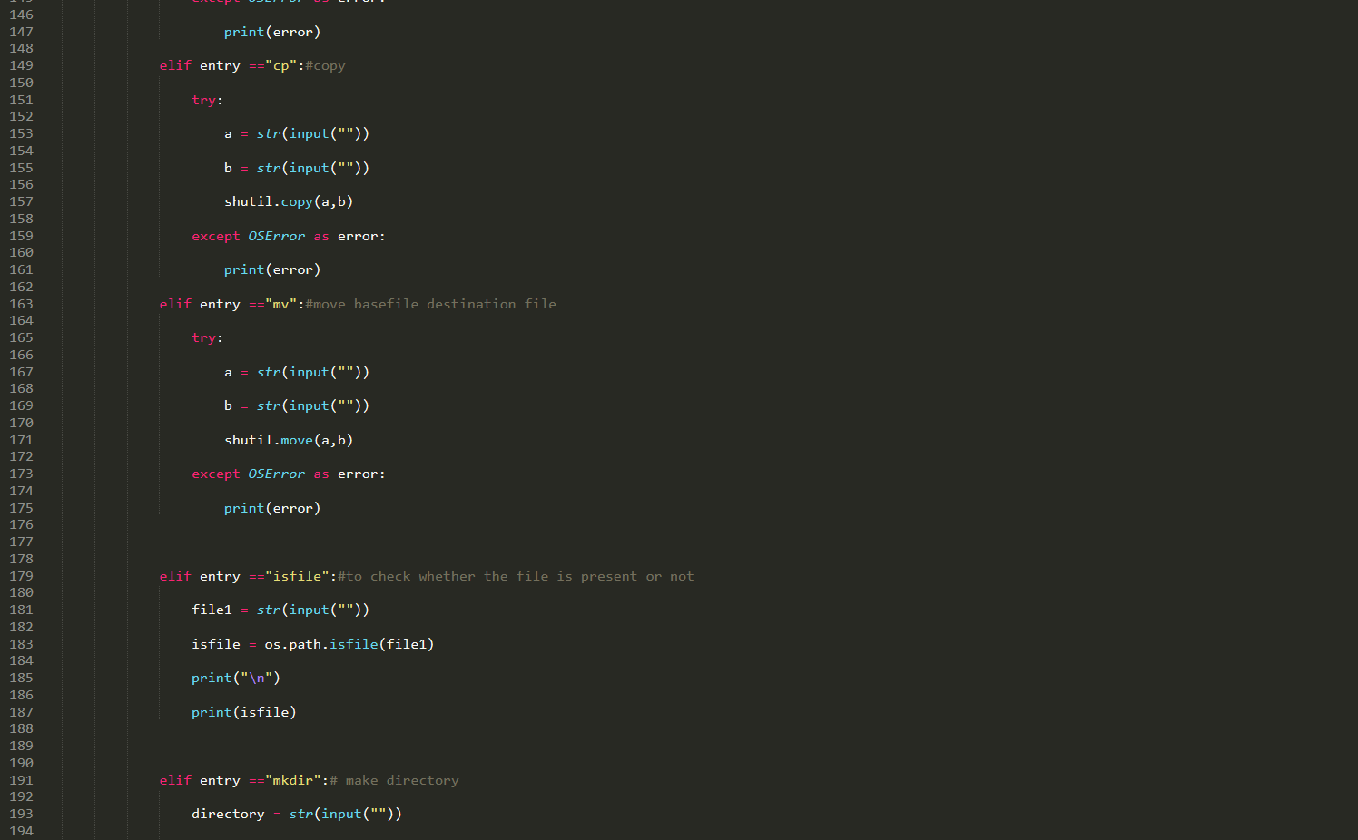

Slide 23
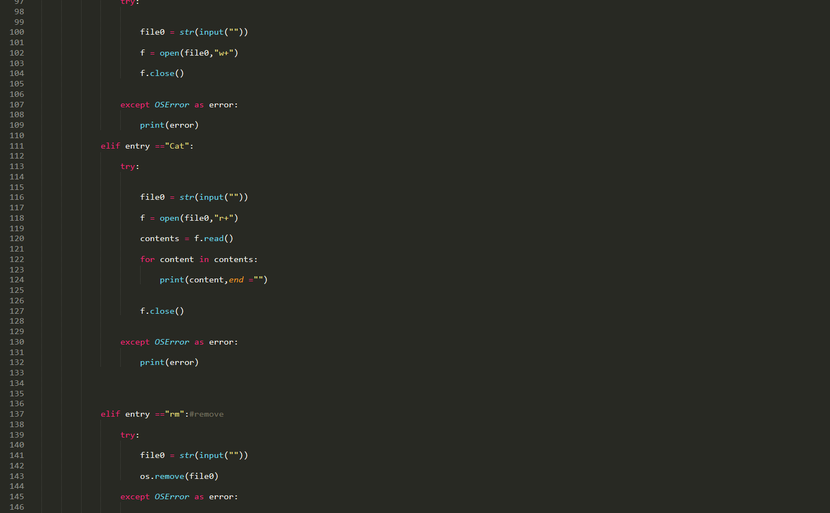

Slide 24
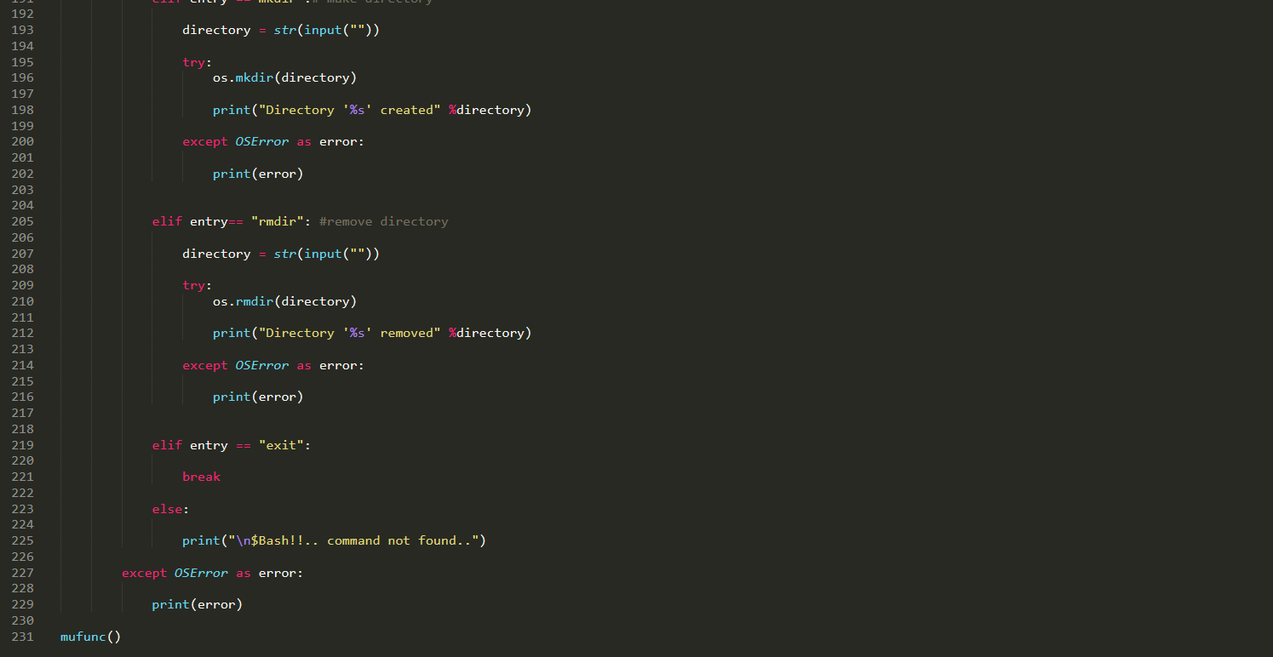

Slide 25
WORKING DEMO

Slide 26
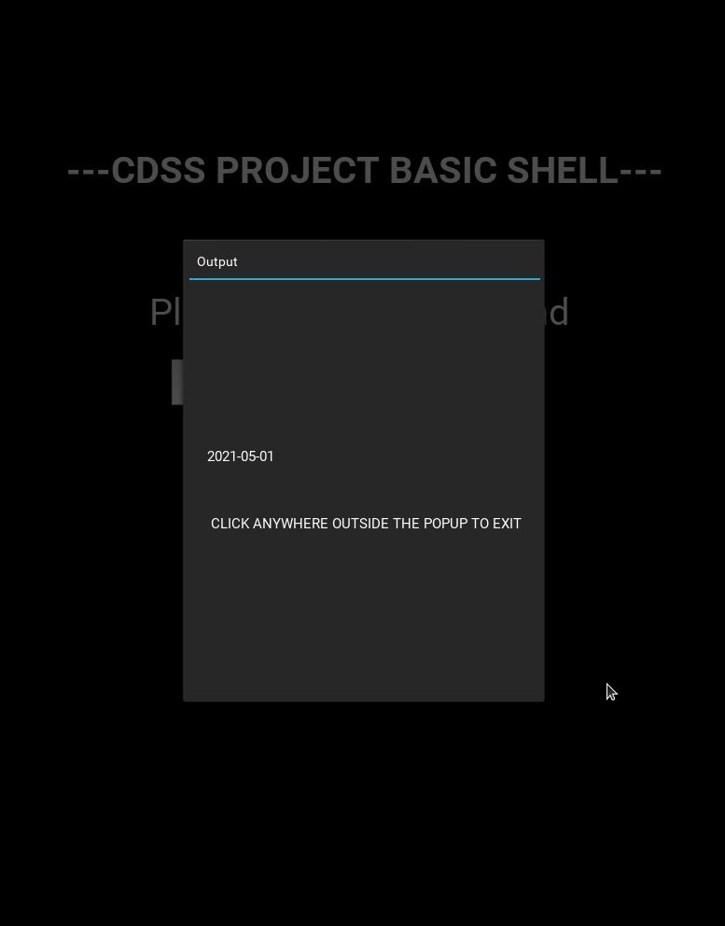
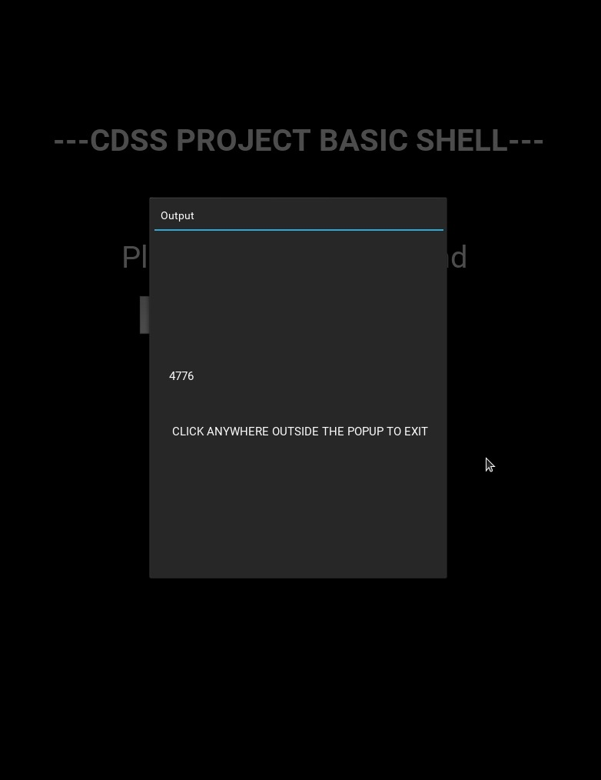
TEST CASES
CASE 1
CASE 2
date - shows the date
pid - displays process id

Slide 27
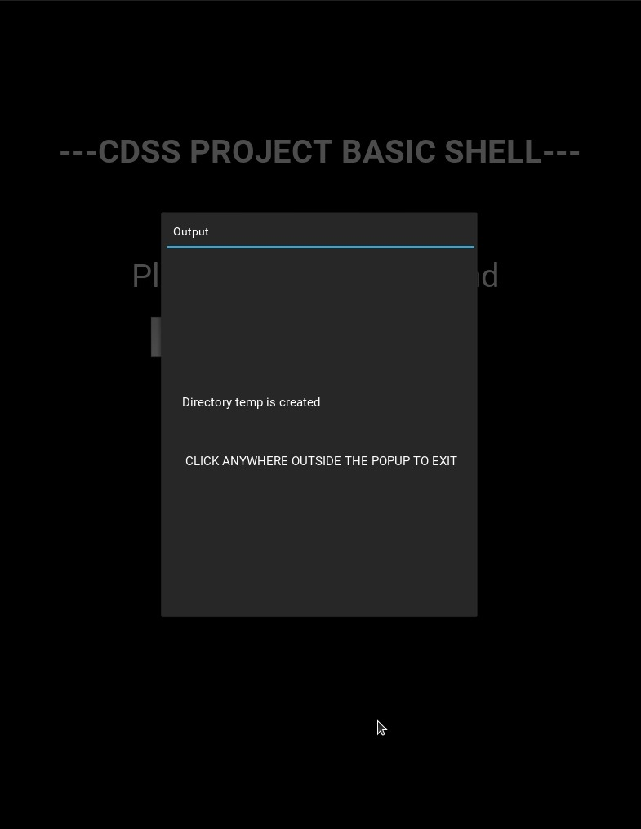
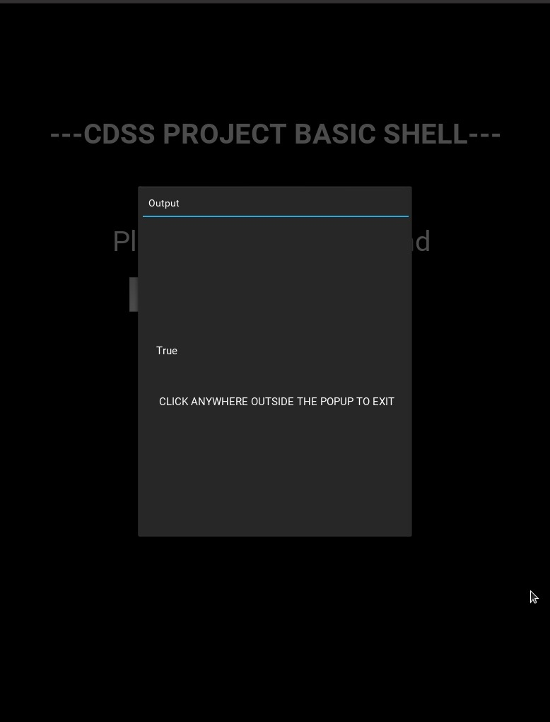
TEST CASES
CASE 3
CASE 4
mkdir - creates a directory
Isdir - checks if the directory is created and available

Slide 28
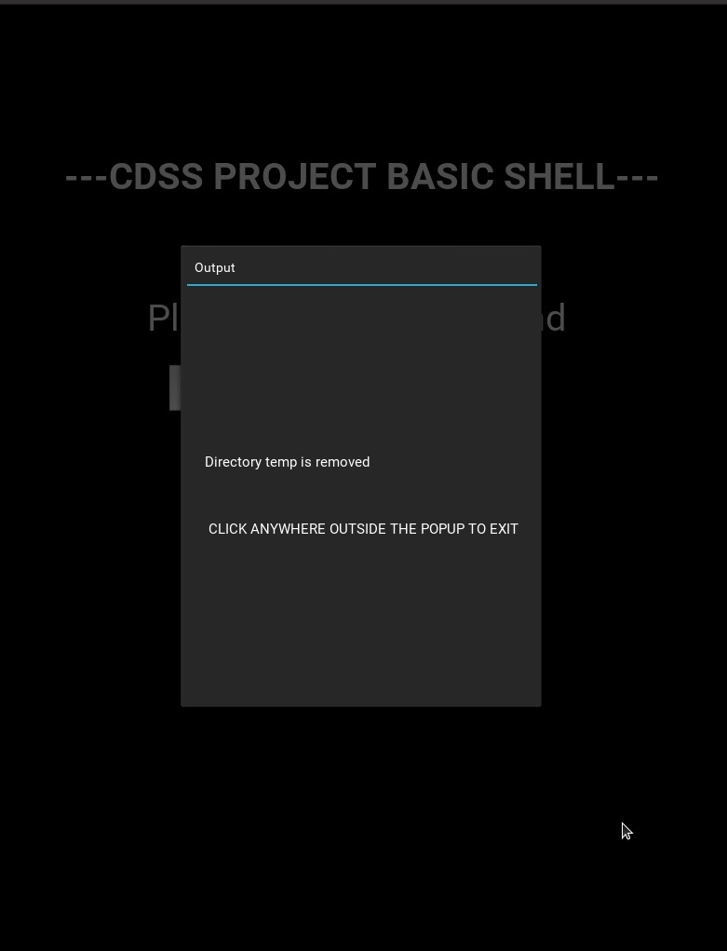
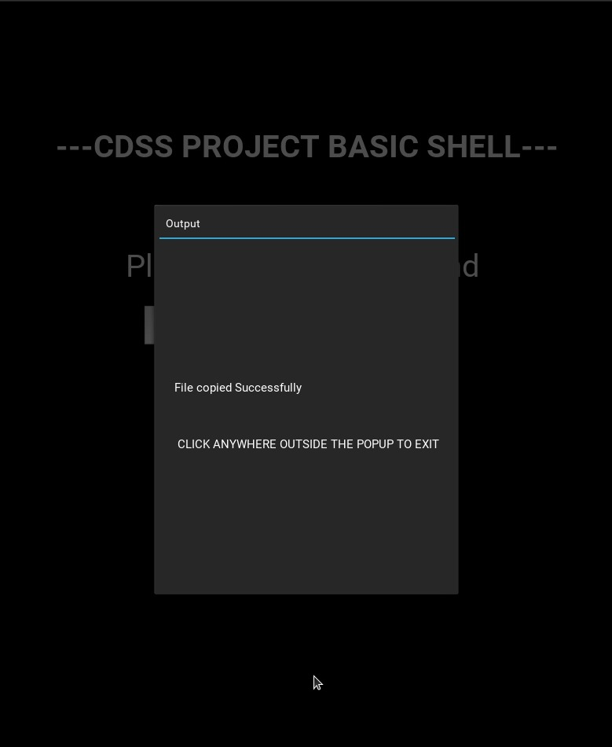
TEST CASES
CASE 5
CASE 6
Rmdir - removes a directory from the system
Cp - copies the contents from one file to another

Slide 29

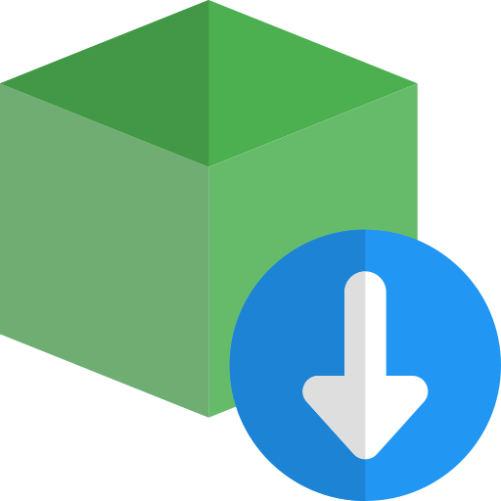

Dependencies Used
From Datetime import date
Import OS
Import Shutil

Slide 30
HUMAN RESOURCES
01
Y. NITHIN SAMEER
02
OMSRI SAINADH REDDY
03
P. SAI KRISHNA ANOOP
04
PRANAV DASIKA
Implementation of backend
System Architecture Design
Implementation of frontend
Testing and code formatting

Slide 31
CONCLUSION
In the course of doing this project we learnt necessary skills such as how to divide work and work in a professional team with designated roles.
We learnt how to use xml and java files and also the development of an android application.
We gained a better understanding of CDSS concepts such as lexical analysis and parsing.
We also learnt the lesson of time management which is required for a team project.

Slide 32


